Slide 1

Credit Card Customer Churn
Team 3
Madhura Jadhav Yuri Oh Ariful Islam Sunil Kumar Akul Jain

Slide 2
Agenda
Problem Statement
Sample EDA
Model Training-Testing & Comparison
Gradient Boosted
Deep Learning
Decision Tree
Logistic Regression
Naïve Bayes
Model Validation
Summary

Slide 3
Problem Statement
A Bank manager wants to take care of customer retention for its product - Credit Card.
The bank wants the data mining team to identify customers that are at risk of leaving the bank.
Team needs to create an automated ‘customer churn prediction’ process by training, validating and deploying a data mining model
Team has given the sample dataset consisting of 10,115 customers with information such as salary, marital status, credit card limit, credit card category, etc.

Slide 4
Data Summary
1 Target variable:
Attrition Flag with two possible values - Attrited Customer, Existing Customer
19 Predictor variables:
6 categorical variables
13 numerical variables
1 Identifier variable:
CLIENTNUM – indicating client number for the customer
The data is imbalanced as only 16% of the records (1,621) represents ‘Attrited’ customers while 84% (8,494) represents ‘Existing’ ones

Slide 5
Data Preprocessing
Missing Data Imputation: ‘unknown’ values of following categorical variables have been replaced with the mode value for the respective variable : Income Category, Marital Status, Education Level
Reclassifying Categorical Variables: Following categorical variables are ordinal in nature. Therefore, we have transformed them to dummy numerical values to include them in correlation matrix
Income Category | T Income Category
Less than $40K | 1
$40K - $60K | 2
$60K - $80K | 3
$80K - $120K | 4
$120K + | 5
Education Level | T Education Level
Uneducated | 1
High School | 2
College | 3
Graduate | 4
Post Graduate | 5
Doctorate | 6

Slide 6
Sample EDA
Contacts_Count_12_mon
Total_Trans_Amt

Slide 7
1: Contacts_Count_12_mon
Number of contacts with the bank by customer in last 12 months
It’s a discrete numerical variable
Range 6 – 0 = 6
No missing value
Summary Statistics
Total Count | 10115
Min | 0
Max | 6
Mean | 2.455
Median | 2
Mode | 3
Std. Deviation | 1.106

Slide 8
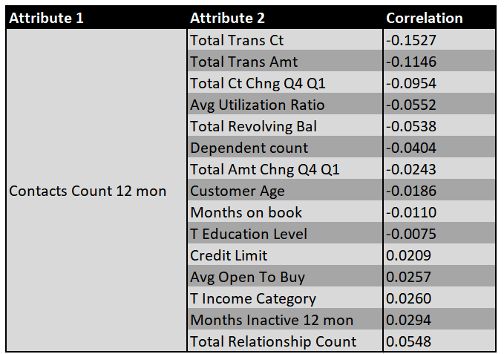
1: Contacts_Count_12_mon
Association with Other Variables- Correlation

Slide 9
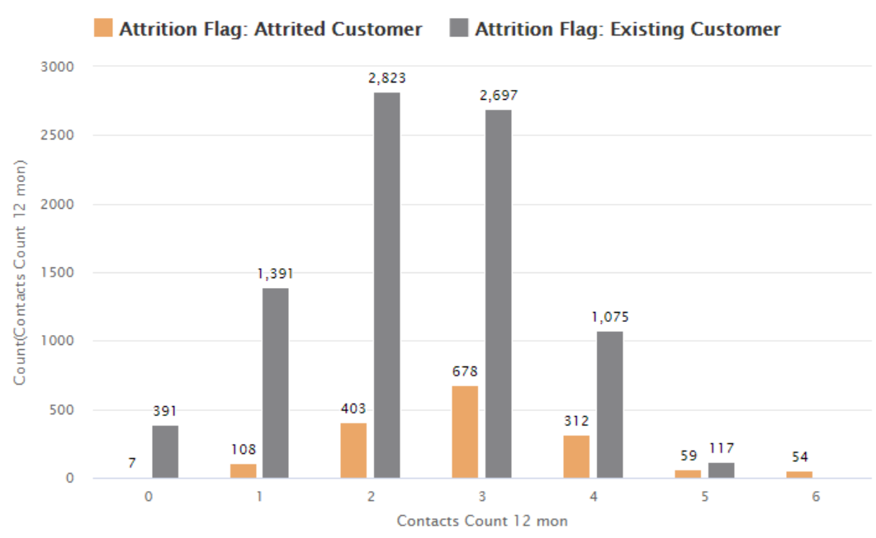
1: Contacts_Count_12_mon
Association with Target Variable
Contacts count | Attrited | Existing | Total
0 | 0.07% | 3.87% | 3.93%
1 | 1.07% | 13.75% | 14.82%
2 | 3.98% | 27.91% | 31.89%
3 | 6.70% | 26.66% | 33.37%
4 | 3.08% | 10.63% | 13.71%
5 | 0.58% | 1.16% | 1.74%
6 | 0.53% | 0% | 0.53%
Total | 16.03% | 83.97% | 100.00%

Slide 10
1: Contacts_Count_12_mon - Summary
It is highly likely that if contacts count is more than 5, customer will be attrited.
Most of the attrited customers contacted the bank at least once.
87% of the attrited customers contacted the bank between 2-4 times.
Correlations to all other variable are weak. Therefore, it is an independent variable.

Slide 11
2: Total_Trans_Amt
Total Transaction Amount by customer in last 12 months
It’s a continuous numerical variable
Range 18,484-510=17,974
No missing value
Summary Statistics
Total Count | 10,115
Min | 510
Max | 18,484
Mean | 4,394.56
Median | 3896
Mode | 4509
Std. Deviation | 3385.52

Slide 12
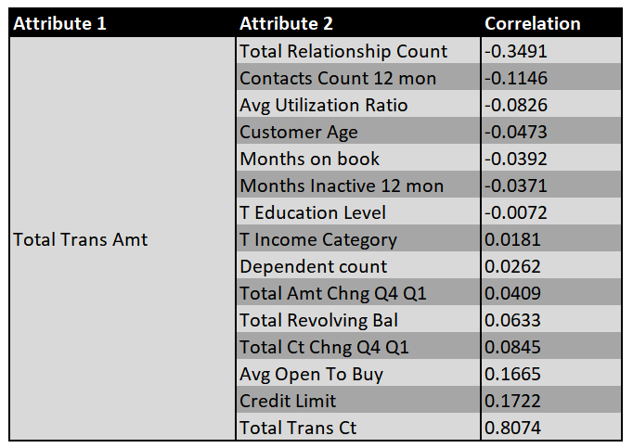
2: Total_Trans_Amt
Association with Other Variables- Correlation

Slide 13
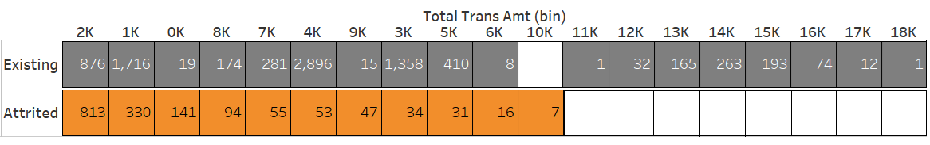
2: Total_Trans_Amt
Association with Target Variable
Total Trans Amt is binned using equal width method with bin width=1000
Following table is sorted based on Attrited Customer column
0
0
0
0
0
0
0
0
0
1284 i.e. 79.21% of Attrited customers have ‘Total Transaction Amount’ less than 3000

Slide 14
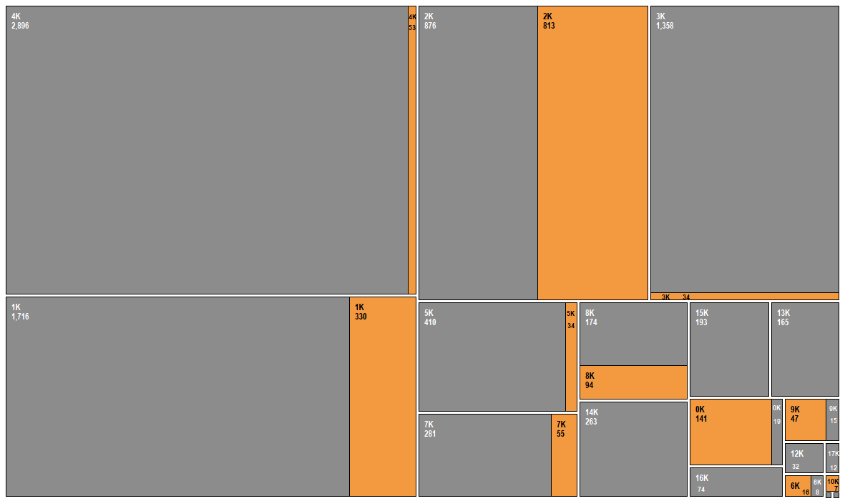
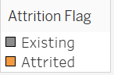
Association with Target Variable

Slide 15
2: Total_Trans_Amt- Summary
Almost 80% of attrited customers have total transaction amount lesser than 3000
None of the attrited customers have total transaction amount more than 10000
Strong correlation of 0.8074 between ‘Total_Trans_Amt’ and ‘Total_Trans_Ct’ variables. This indicates that these variables are directly proportional. We can skip one of these variables in model building.
‘Total Relationship Count’ variable has a considerable correlation of -0.3491. However, it is not strong enough to skip this variable in model building.
Correlation to all other variables are weak.

Slide 16
Model Training-Testing & Comparison

Slide 17
Model & Variable Selection
Based on EDA Phase, we recommended following 9 variables and 4 candidate models to predict customer churn
Candidate Models:
Gradient Boosted Tree
Deep Learning
Decision Tree
Logistic Regression
Variables:
Gender
Total Relationship Count
Months Inactive 12 mon
Contacts Count 12 mon
Credit Limit
Total Revolving Bal
Total Trans Ct
Total Ct Chng Q4 Q1
Avg Utilization Ratio

Slide 18
RapidMiner Design
Following is the split of the data that we have used for candidate models:
For Training and Testing,
80% of the total records = 8,092
5-Fold cross validation
For Validation,
20% of the total records = 2,023
For Performance measurement, we are focusing on following 2 metrics
Accuracy
AUC

Slide 19
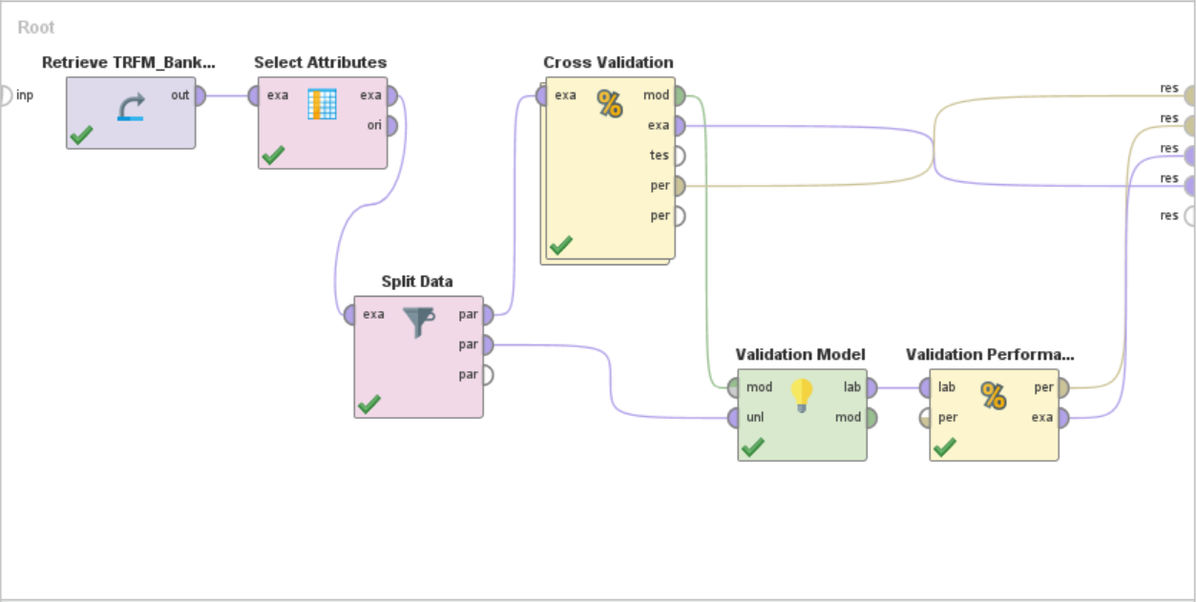
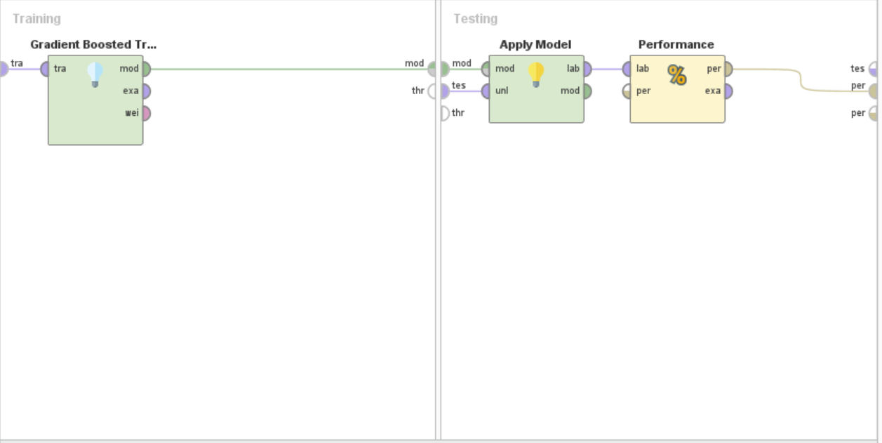
Gradient Boosted

Slide 20
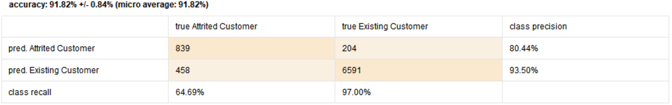
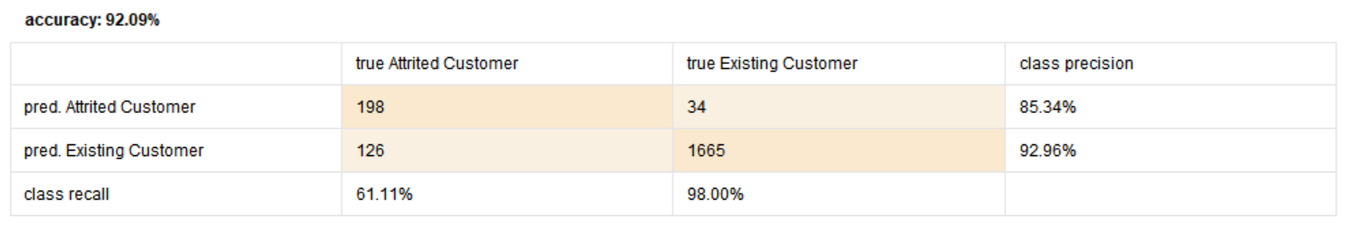
Gradient Boosted
Cross Validation (Training-Testing)
Validation

Slide 21
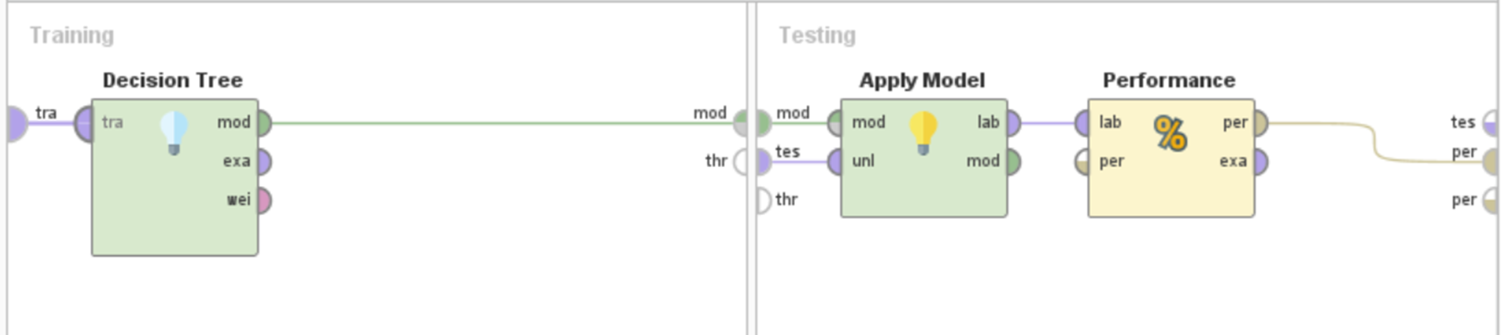
Decision Trees

Slide 22
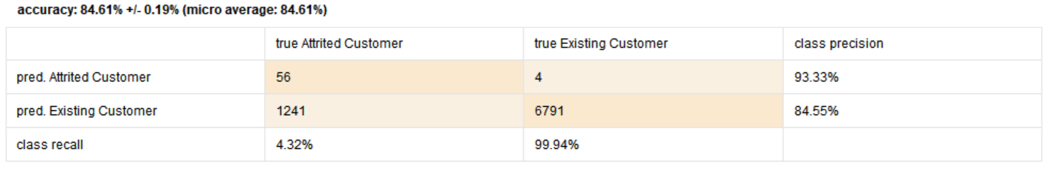
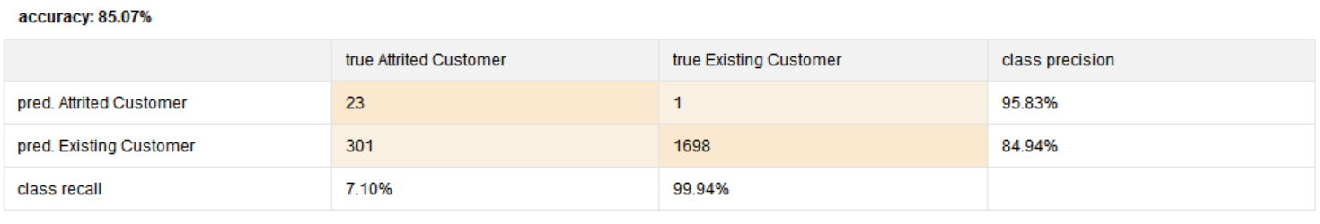
Decision Trees
Cross Validation (Training-Testing)
Validation

Slide 23
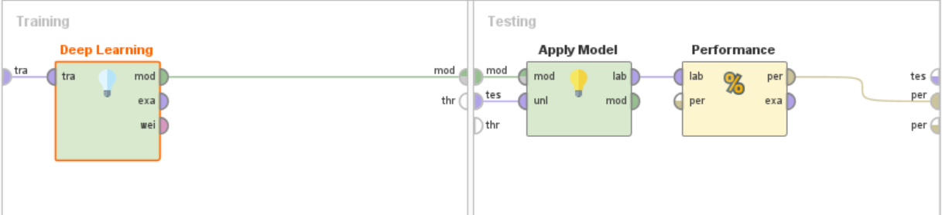
Deep Learning

Slide 24
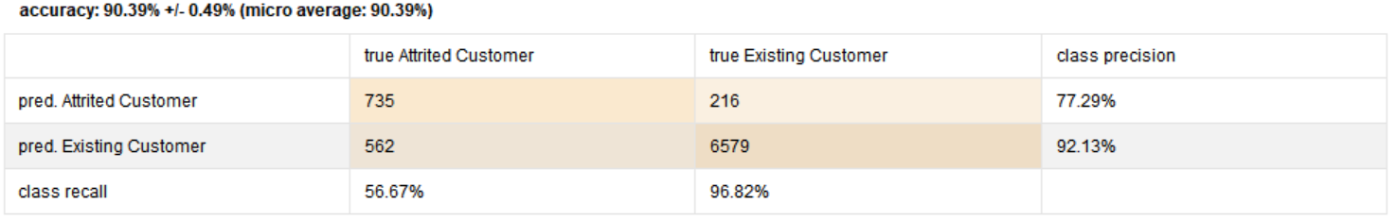
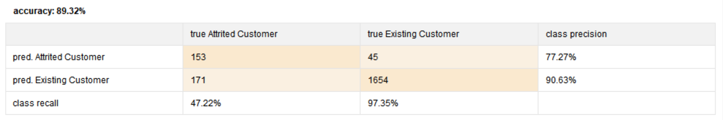
Deep Learning
Cross Validation (Training-Testing)
Validation

Slide 25
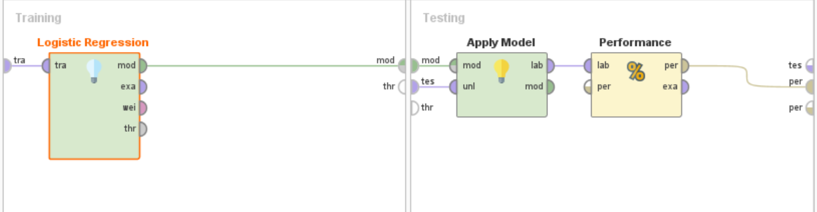
Logistic Regression

Slide 26
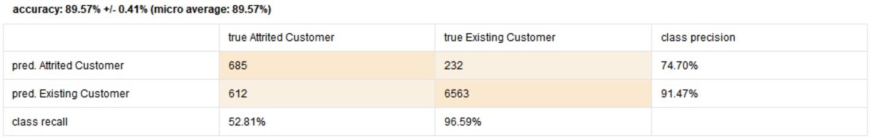
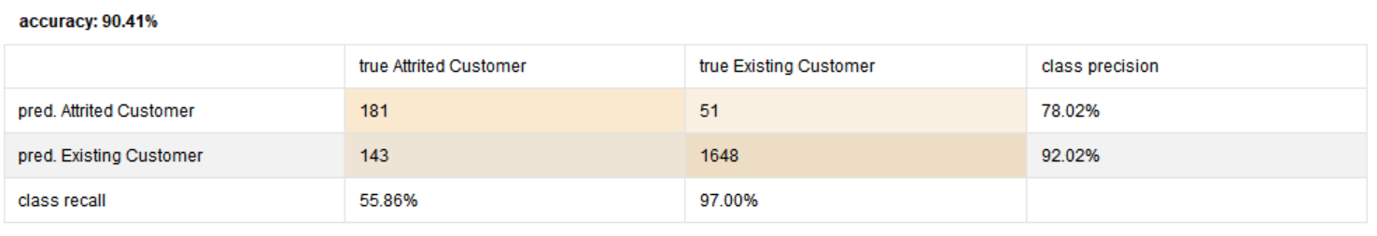
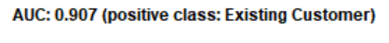
Cross Validation (Training-Testing)
Logistic Regression
Validation

Slide 27
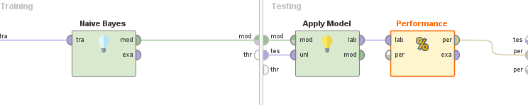
Naive Bayes

Slide 28
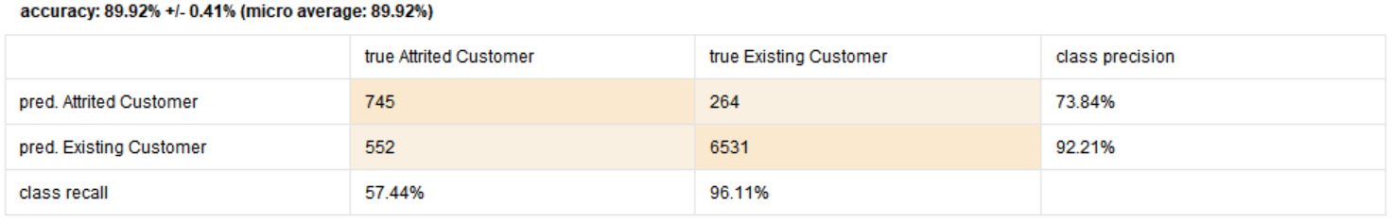
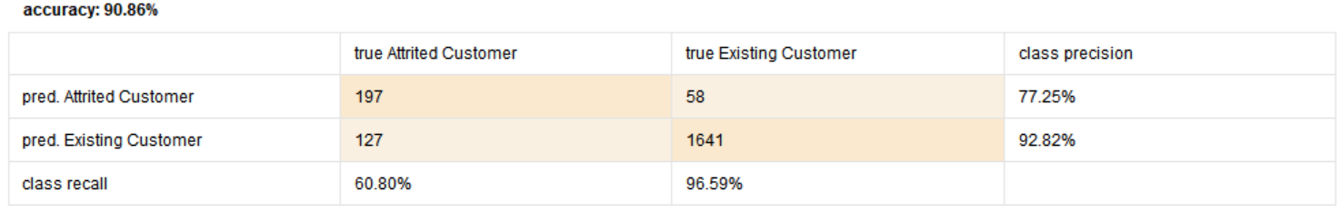
Naive Bayes
Cross Validation (Training-Testing)
Validation

Slide 29
Model Comparison
Performance Metric |  | Gradient Boosting | Deep Learning | Decision Tree | Logistic Regression | Naïve Bayes
 | Accuracy | 91.82% +/-0.84% | 90.39% +/- 0.49% | 84.61% +/- 0.19% | 89.57% +/- 0.41% | 89.92% +/- 0.41%
 | AUC | 0.933 +/- 0.010 | 0.928 +/- 0.004 | 0.521 +/- 0.005 | 0.899 +/- 0.008 | 0.904 +/- 0.008
Cross Validation (Training-Testing)
Performance Metric |  | Gradient Boosting | Deep Learning | Decision Tree | Logistic Regression | Naïve Bayes
 | Accuracy | 92.09% | 89.32% | 85.07% | 90.41% | 90.86%
 | AUC | 0.938 | 0.897 | 0.536 | 0.907 | 0.915
Validation

Slide 30
Model Selection
Based on the performance metrics, we selected Gradient Boosted as our model
Training - Testing
Accuracy: 91.82% +/-0.84%
AUC: 0.933 +/- 0.010
Validation
Accuracy: 92.09%
AUC: 0.938
To further improve this performance, we explored following techniques:
Forward Selection- to verify if the features used are best fit
Model Parameter Tuning- to see if we can improve the performance by changing parameters for the selected model

Slide 31
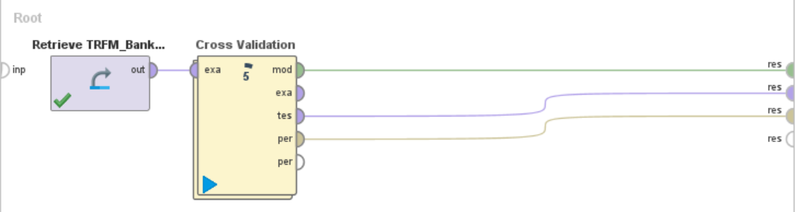
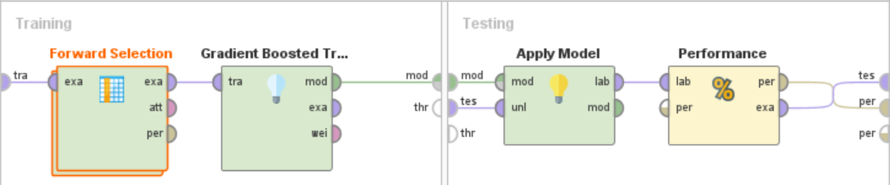
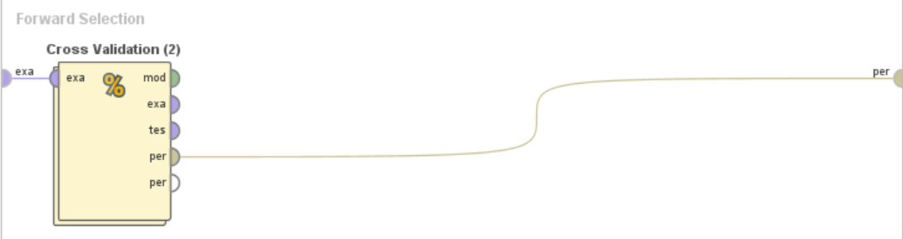
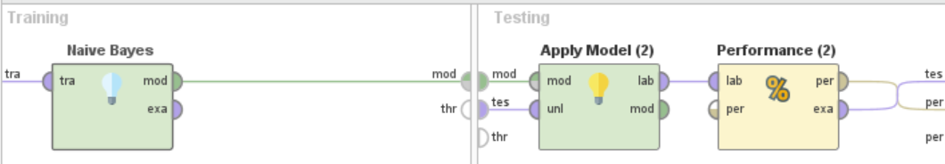
Feature Selection

Slide 32
Feature Selection Recommendation
Following are the features recommended by Forward Selection technique:
Gender
Total Relationship Count
Months Inactive 12 mon
Contacts Count 12 mon
Credit Limit
Total Revolving Bal
Total Trans Ct
Total Ct Chng Q4 Q1
Avg Utilization Ratio Customer Age
Notes:
a

Slide 33
Model Comparison after Forward Selection
Performance Metric |  | GB with EDA features | GB with Forward Selection features
 | Accuracy | 91.82% +/- 0.84% | 91.62% +/- 0.83%
 | AUC | 0.933 +/- 0.010 | 0.934 +/- 0.010
Cross Validation (Training-Testing)
Performance Metric |  | GB with EDA features | GB with Forward Selection features
 | Accuracy | 92.09% | 92.04%
 | AUC | 0.938 | 0.938
Validation

Slide 34
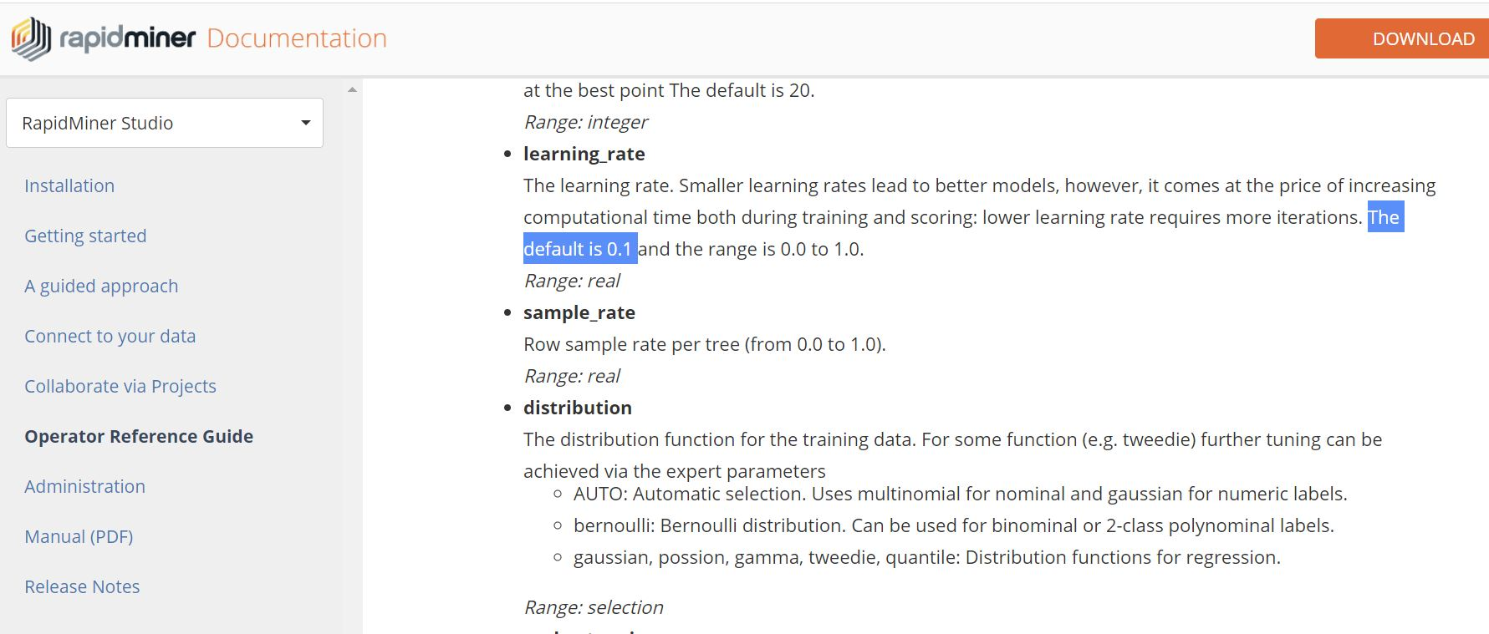
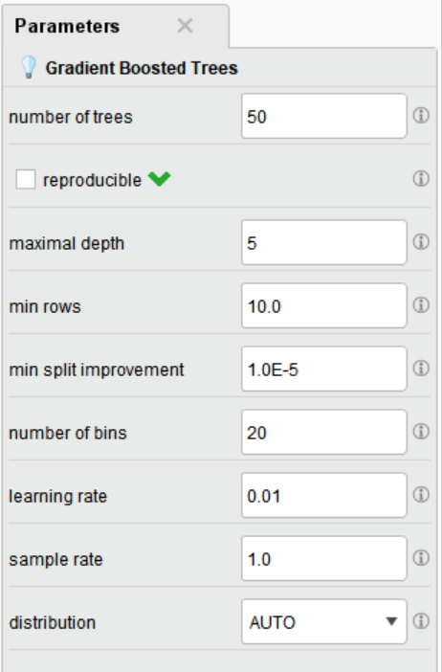

Model Parameter Tuning

Slide 35
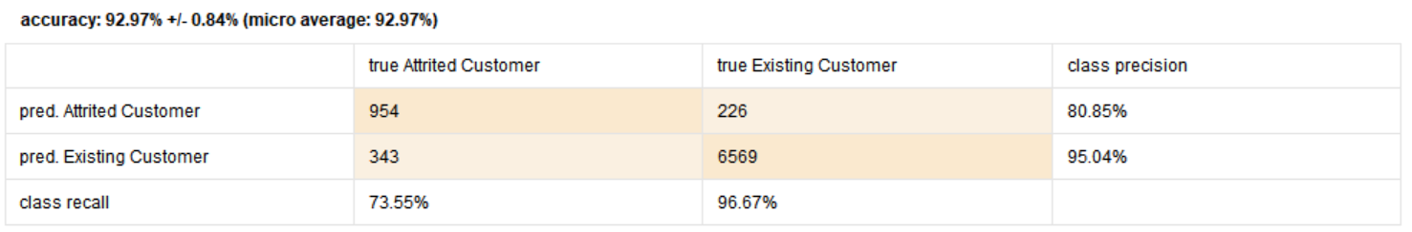
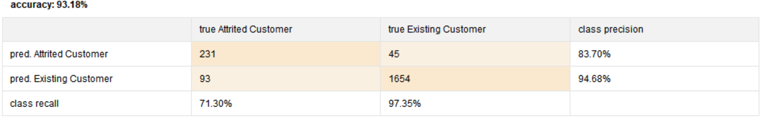
Tuned Gradient Boosted with EDA Features
Cross Validation (Training-Testing)
Validation

Slide 36
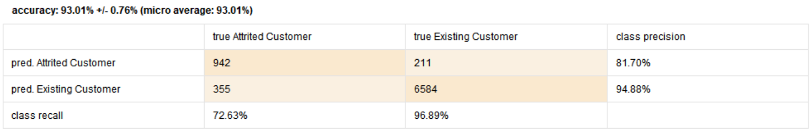
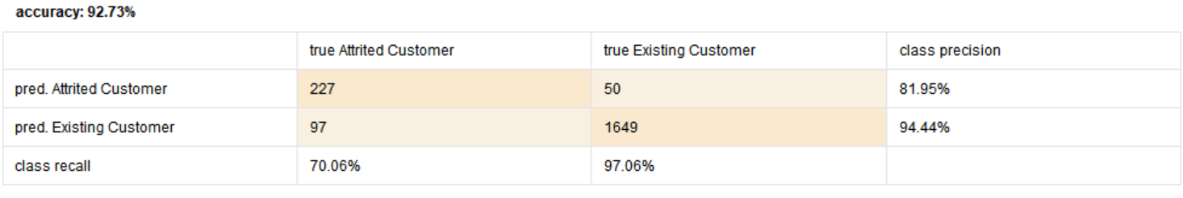
Tuned Gradient Boosted
with FS Features
Cross Validation (Training-Testing)
Validation

Slide 37
Comparison
Cross Validation (Training-Testing)
Performance Metric |  | EDA Features |  | FS Features
 |  | Non-Tuned Parameters | Tuned Parameters | Non-Tuned Parameters | Tuned Parameters
 | Accuracy | 91.82% +/- 0.84% | 92.97% +/- 0.84% | 91.62% +/- 0.83% | 93.01% +/- 0.76%
 | AUC | 0.933 +/- 0.010 | 0.958 +/- 0.008 | 0.934 +/- 0.010 | 0.960 +/- 0.007
Validation
Performance Metric |  | EDA Features |  | FS Features
 |  | Non-Tuned Parameters | Tuned Parameters | Non-Tuned Parameters | Tuned Parameters
 | Accuracy | 92.09% | 93.18% | 92.04% | 92.73%
 | AUC | 0.938 | 0.959 | 0.938 | 0.963

Slide 38
Finalized Model
Based on EDA, Training and Testing Phase, we have recommended Gradient Boosted Tree model with following 9 features to predict customer churn
Features:
Gender,
Total Relationship Count,
Months Inactive 12 months,
Contacts Count 12 mon,
Credit Limit,
Total Revolving Bal,
Total Trans Ct,
Total Ct Chng Q4 Q1,
Customer Age
Performance Metric |  | Gradient Boosted Tuned
 |  | Training Testing | Validation
 | Accuracy | 93.01% | 92.73%
 | AUC | 0.960 | 0.963

Slide 39
Model Validation

Slide 40
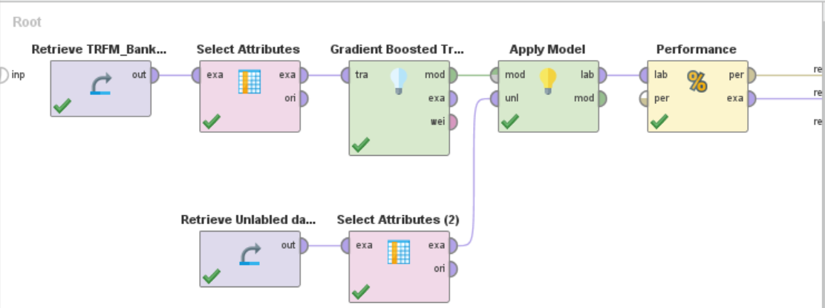
RapidMiner Implementation

Slide 41
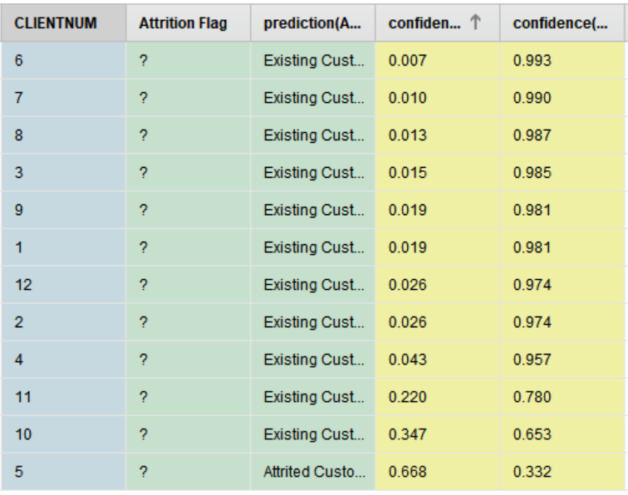
Results with revisited Feature Set
11:1 Existing Vs. Attrited proportion for the model with old feature set

Slide 42
Revisit
Model Revisit:
Revisited other 4 models: Decision Tree, Deep Learning, Logistic Regression and Naïve Bayes
Above 4 of them showed 12:0 Existing Vs. Attrited proportion for the same features
Gradient Boosted Model gave 11:1 Existing Vs. Attrited proportion
Feature Revisit (Model Retraining):
Manual application of forward selection to supplement old feature set
Recursively appended 1 feature to the existing 9 features, at a time, to observe improvements to the model performance
Addition of feature “Total Trans Amt” showcased significant improvement in the result

Slide 43
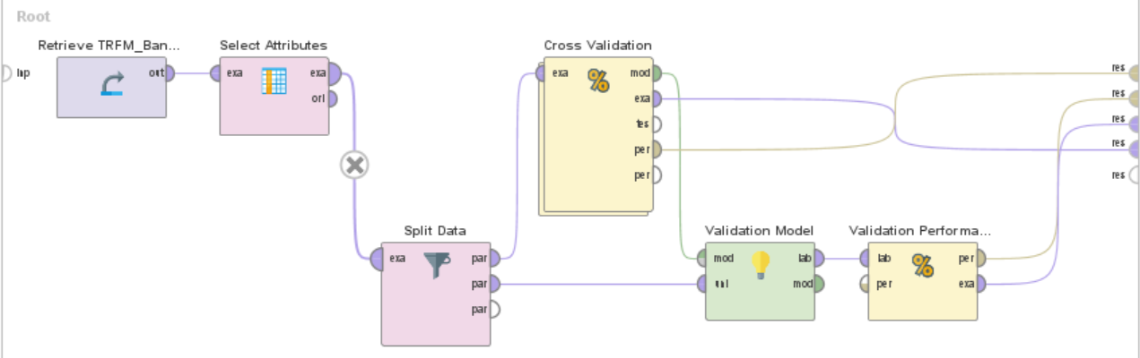
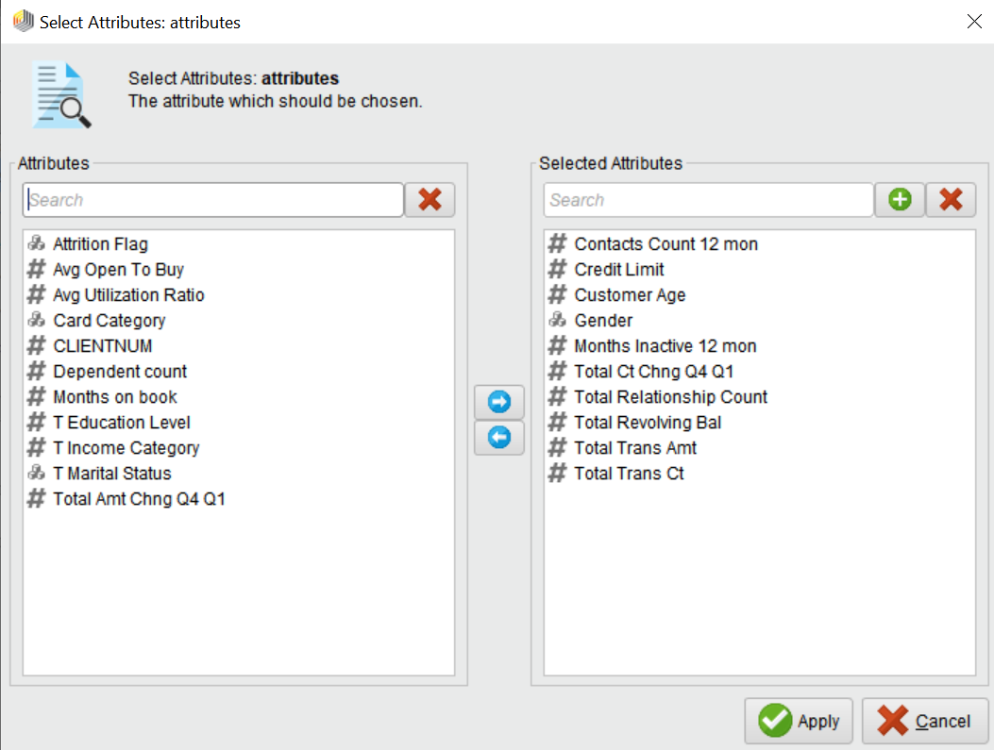
Model Retraining

Slide 44
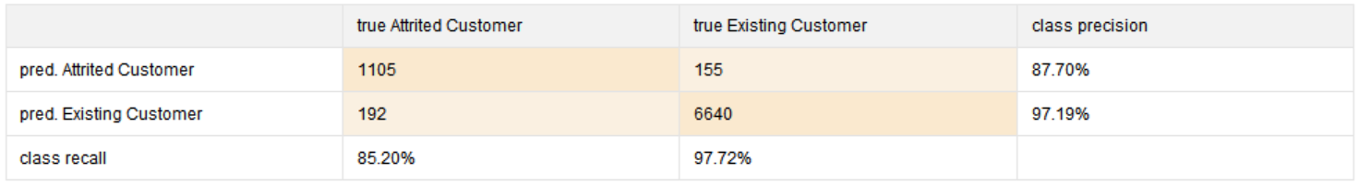
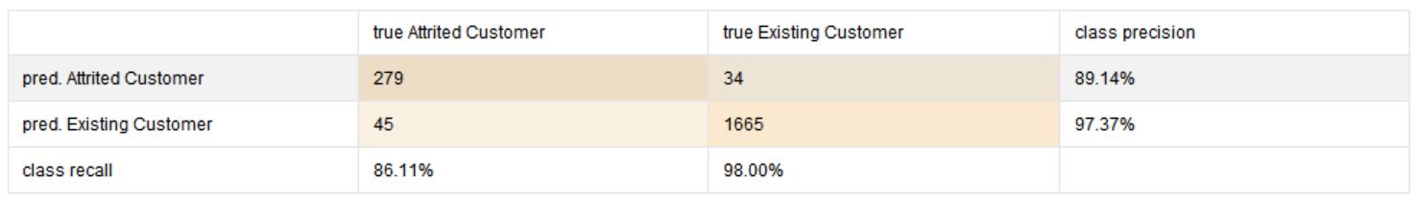
Cross Validation (Training-Testing) Performance
Validation Performance
Performance Comparison
Performance Metric |  | 9 Features (old) |  | 10 Features (revisited)
 |  | Cross Validation (Training – Testing) | Validation | Cross Validation (Training – Testing) | Validation
 | Accuracy | 93.01% | 92.73% | 95.71% | 96.09%
 | AUC | 0.960 | 0.963 | 0.986 | 0.987

Slide 45
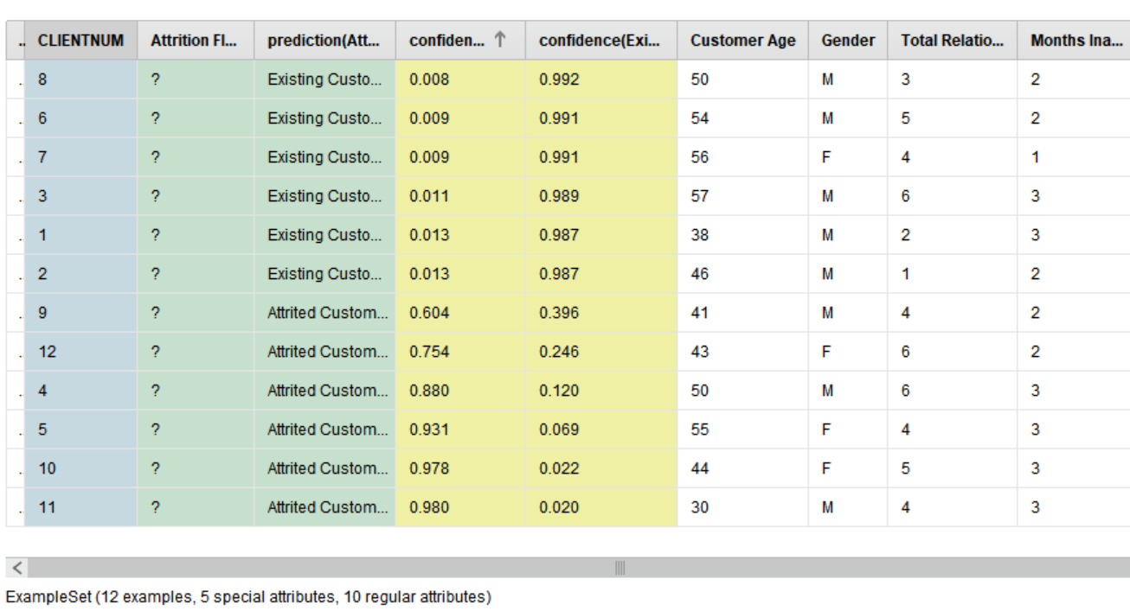
Results with old Feature Set
6:6 Existing Vs. Attrited proportion for the model with revisited feature set

Slide 46
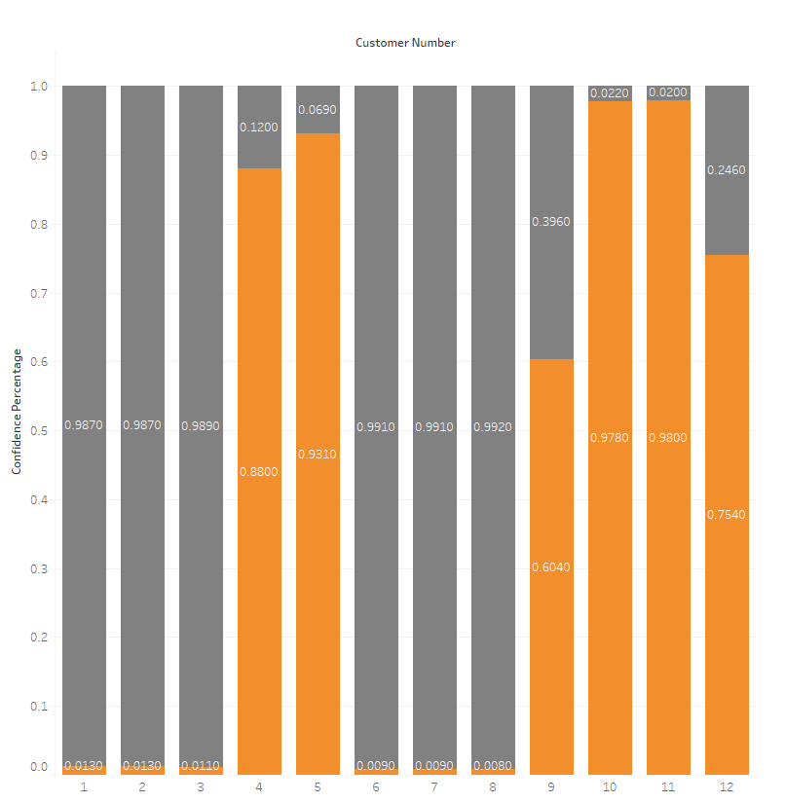
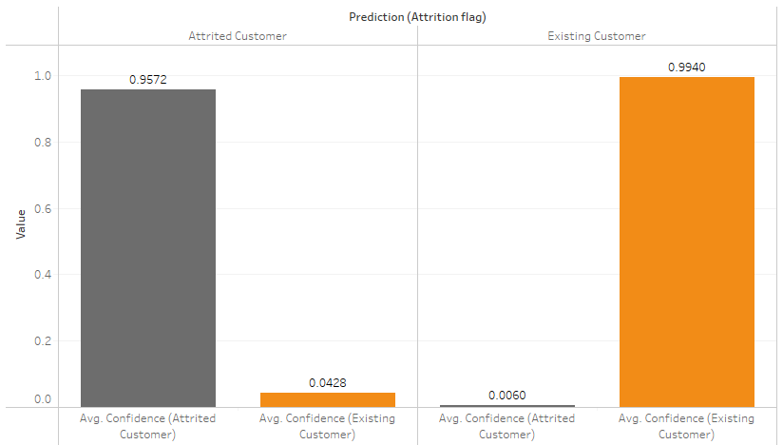
Results
Confidence Vs. Customer Number
Average Confidence Across Both Classes (Attrited vs. Existing)

Slide 47
Summary
Best model for this customer churn problem is Gradient Boosted Model with following 10 features:
Gender, Total Relationship Count, Months Inactive 12 mon, Contacts Count 12 mon, Credit Limit, Total Revolving Bal, Total Trans Ct, Total Ct Chng Q4 Q1, Customer Age, Total Trans Amt
Performance for Model Training-Testing:
Cross Validation Accuracy = 95.71%
Cross Validation AUC = 0.986
Validation Accuracy = 96.09%
Validation AUC = 0.987
Performance for Unlabeled Data:
We got 50-50 proportion with -
CLIENTNUM 1, 2, 3, 6, 7, 8 as Existing Customer
CLIENTNUM 4, 5, 9, 10, 11, 12 as Attrited Customer

Slide 48
Thank You

